Slide 1

Java + Mobile course by Enered

Slide 2
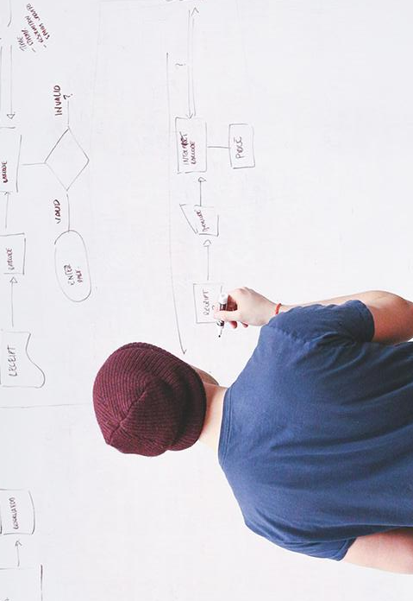
HELLO!
I am Vlad Butnaru
I will be your trainer for this Java session!
PS: It’ll be awesome!

Slide 3
Please pay attention
This session is very important!

Slide 4
You are almost here
Primitive si structuri repetitive + conditionale
OOP – Clase, obiecte, metode, constructori
UI - SWING

Slide 5
What will we do today
Review of May
Inheritance and method overloading
Interfaces and method overriding
Exercise (you do it this time)
What’s up for June?

Slide 6
1. Review of May
Java basics (JVM, Java update scheme)
Primitives (int, double, String, char)
Repetitive and conditional structures
Mathematical operators (+-*/%)
Arrays [vectors] (int[] ; double[]; String[])
Naming conventions (camelCase)
Implicit casting (int)2.5

Slide 7
1. Review of May
OOP Introduction (basic concepts)
Classes
Instances
ArrayLists <>
Constructors and methods
Naming conventions
Inheritance and method overloading (today)

Slide 8
1. Review of May
You had an exam (with promising results)
You had built ~4 functional applications
You actively contributed to the general atmosphere
You know each other and myself
You developed both your logical and your analytical skills

Slide 9

1. Review of May
Well done!

Slide 10
2. Inheritance
Crucial OOP concept;
You use it when you have a class that borrows the attributes and/or methods from another class (called superclass);
A class can only extend ONE class;
Public class Carrefour extends Store{}
Public class Cat extends Animal{}
Public class Audi extends Car{}

Slide 11
2. Inheritance
DEMO

Slide 12
3. Method overloading
Another crucial OOP concept;
You have used it while implementing multiple constructors;
This concept allows you to have >1 method with the same name, but different parameters;
The method header is called SIGNATURE;
The SIGNATURE is UNIQUE while inside a class;

Slide 13
3. Method overloading
DEMO

Slide 14
4. Interfaces and overriding
Interfaces contain only the method SIGNATURES;
They ensure the developer that the classes that IMPLEMENT an interface ALWAYS implement its methods;
Public interface countable{
Public int count();
}

Slide 15
4. Interfaces
Public class Apple implements countable{
@Override
Public int count(){
Return this.numberOfApples;
}
}

Slide 16
4. Method overloading
DEMO

Slide 17
5. Exercise
2 examples of each concept learned today

Slide 18
5. June preview
We’re gonna clarify each and every aspect of OOP (they’re important)
We’re gonna start building apps with UI
You’re gonna learn how to store and read data from a Database (MySQL)
You’re gonna work @ your projects ☺
We’re gonna go one level deeper into Java SE standards and techniques

Slide 19
THANKS!
Any questions?
You can find me at:
@web: http://vladbutnaru.com/
@facebook· Vladut Butnaru
@linkedin· Vlad Butnaru
@email : vlad2me@gmail.com
@phone : +40 0754 827 620

Slide 20
Feedback please!
http://bit.do/feedbackvlad

